Slide 1
Neurotransmitters (NT)
1. Synthesized in a neuron
2. Stored in vesicles in the presynaptic terminal & released with a specific effect on target postsynaptic cell via receptors
3. Exogenous administration (e.g. injecting into body/brain, applying to neuron) causes the same effect as natural release from neuron
4. A specific mechanism exists to remove it from the synapse
5. Each neuron makes only one or a few neurotransmitters
6. Neurons or target cells can have multiple receptors, making them sensitive to multiple NTs.
7. Drugs can act on receptors or affect synthesis/removal of the neurotransmitter
agonist: drug has same or bigger effect on receptor as endogenous NT
antagonist: drug blocks the effects of NT
Examples: Acetylcholine, Glutamate, GABA, Catecholamines, Neuropeptides

Slide 2
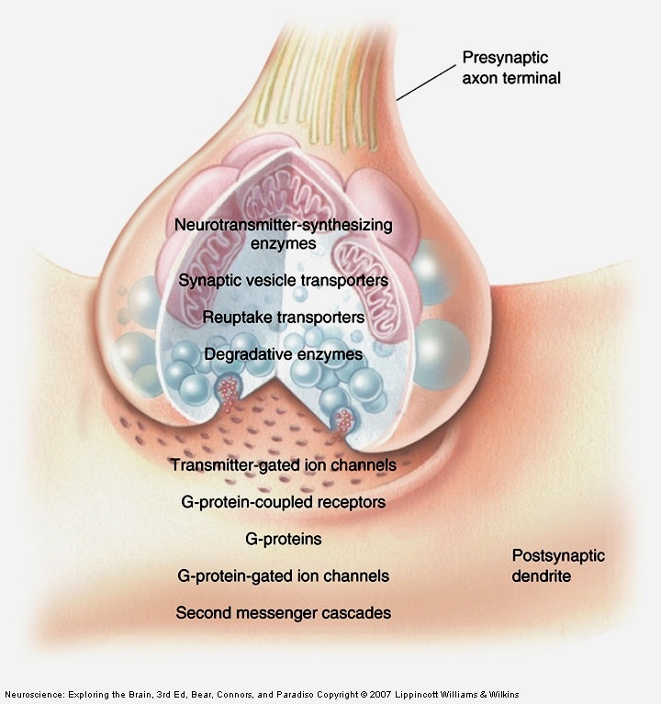

Slide 3
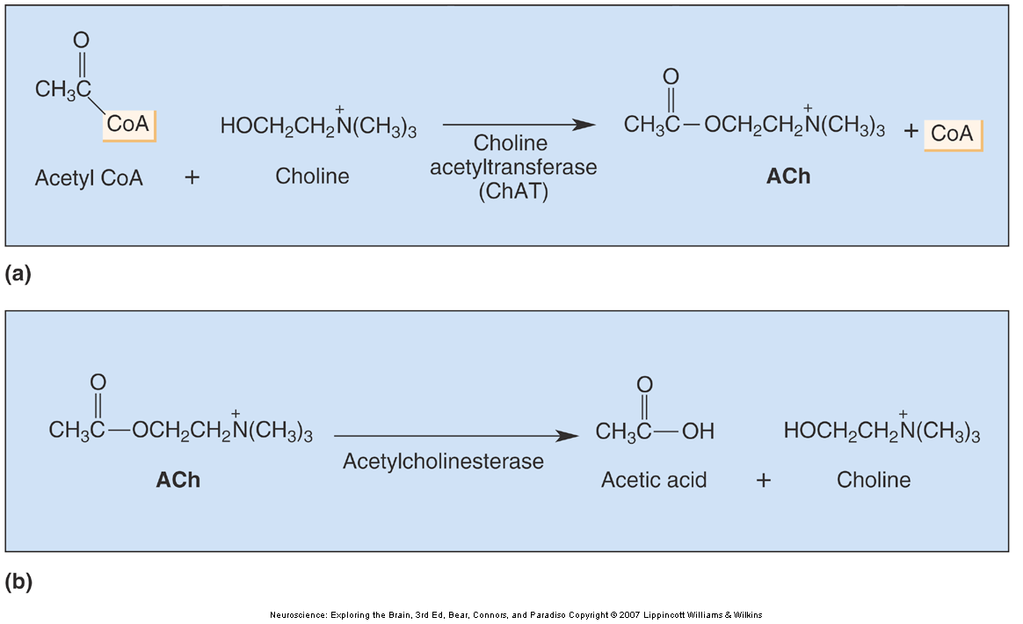
Acetylcholine - the first NT
Synthesis
Degradation

Slide 4
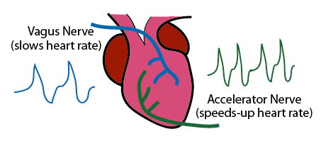
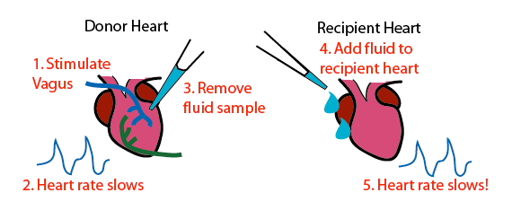
Otto Loewi and Vagusstoff

Slide 5
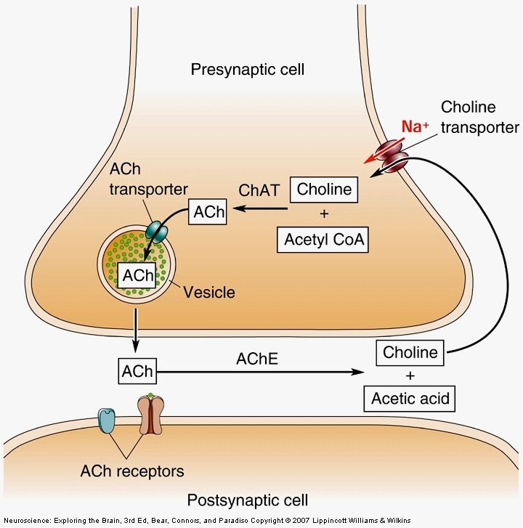
Cholinergic Synapse

Slide 6
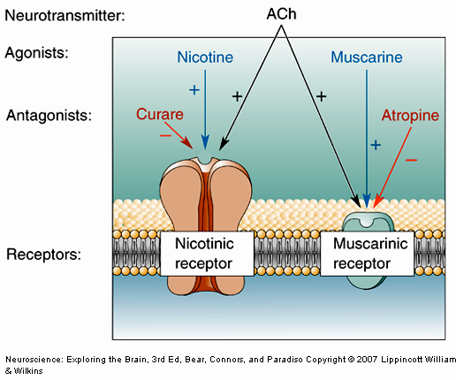
Terminology:
Neuromuscular Junction
Slows Heart

Slide 7
2 Types of neurotransmitters
Classical
small molecules
Neuropeptides
Size
small
(like amino acid
or amine)
large
(4-100 a.a. polypeptide)
Synthesis
uptake or enzymes
protein synthesis
Vesicles
small,
filled by transporters
large
secreted proteins from RER
Duration of action
fast but short
slow & long

Slide 8
Classical small-molecule NTs
Amino Acids
COOH
CH2 NH2
Glycine
Glutamate
GAD
GABA
γ-amino-butyric acid
common chemicals synthesized by many cells during general metabolism...

Slide 9
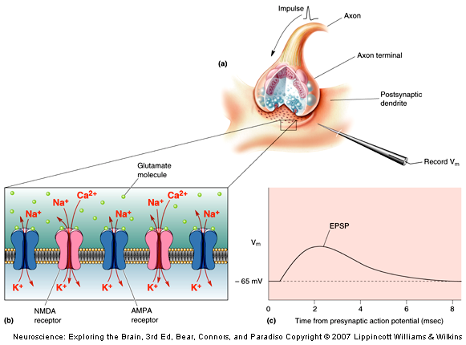
Glutamate
the primary excitatory
neurotransmitter

Slide 10
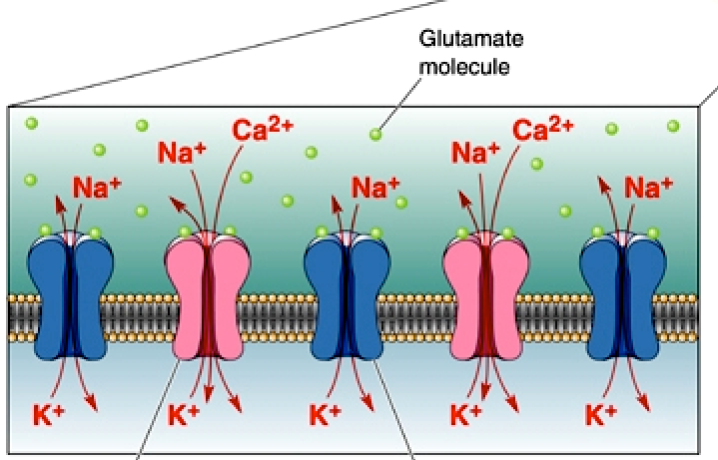
Glutamate
the primary excitatory
neurotransmitter

Slide 11
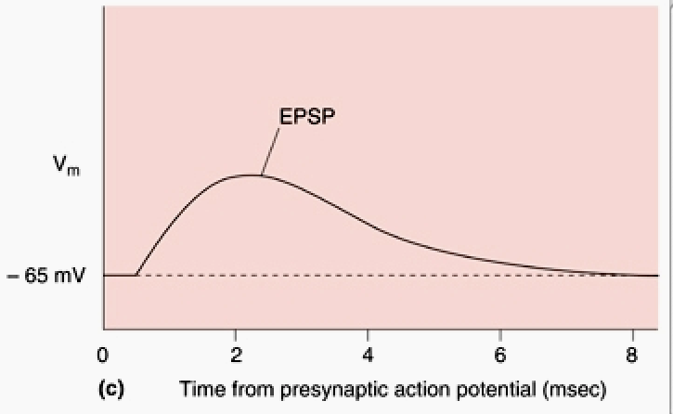
Glutamate
the primary excitatory
neurotransmitter

Slide 12
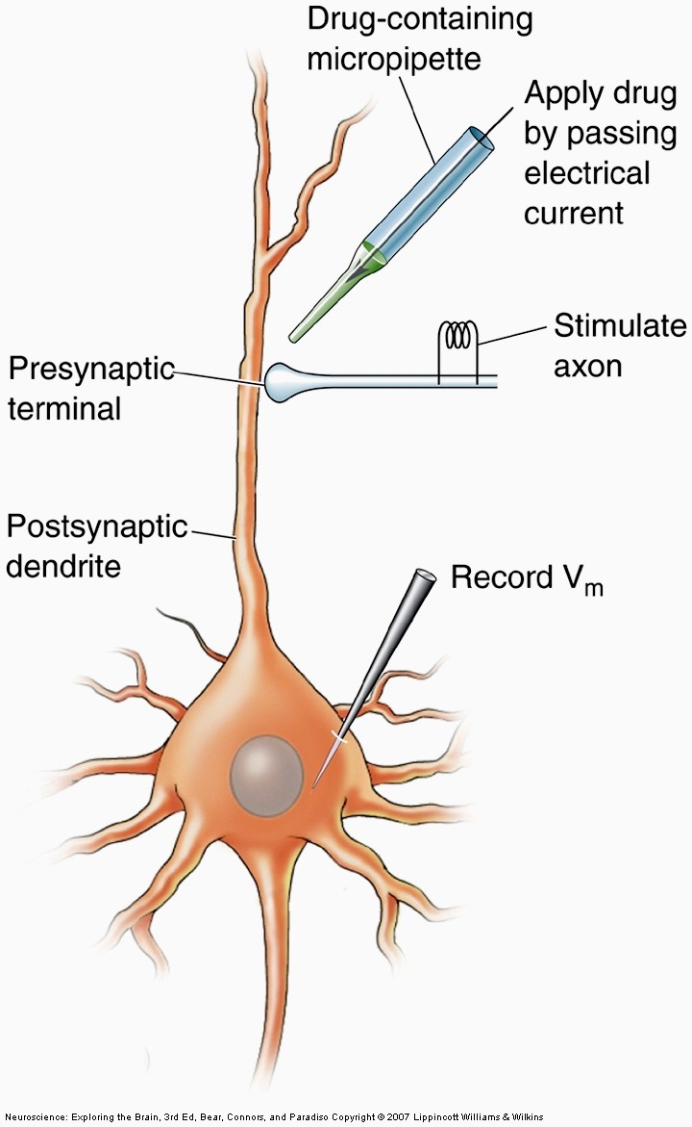
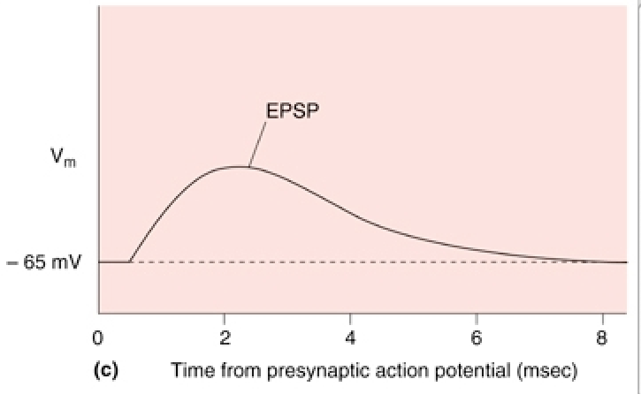
apply drug (e.g. Glu or agonist)

Slide 13
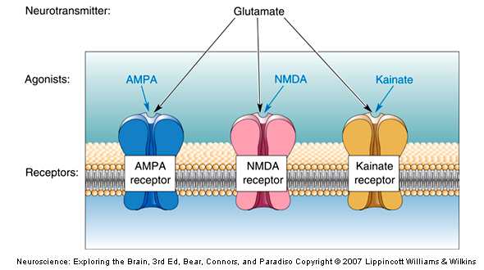

Slide 14
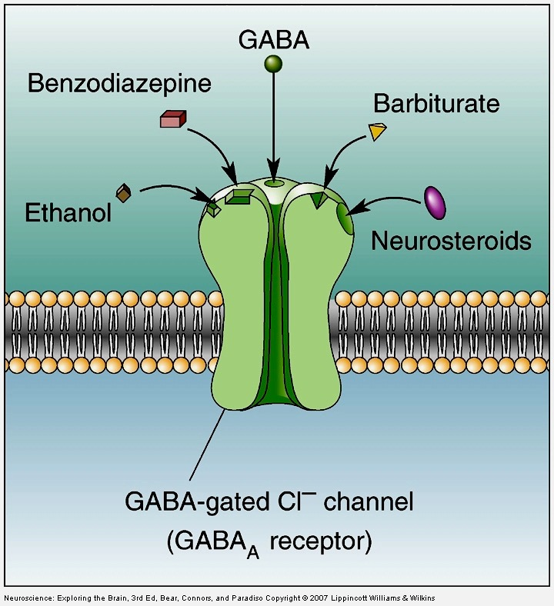
GABA:
the primary
inhibitory
neurotransmitter
open Cl- channels
which lowers Vm

Slide 15
Classical NTs & Synthetic pathways
enzyme 1
enzyme 2
cytoplasmic
precursor
intermediate
neurotransmitter
transporter
vesicles

Slide 16
Classical NTs & Synthetic pathways
Amines: Catecholamines (DA, NE, Epi)
tyrosine hydroxylase
tyrosine
decarboxylase

Slide 17
Classical NTs & Synthetic pathways
Amines: Catecholamines (DA, NE, Epi)
presence of TH makes neuron DAergic
tyrosine hydroxylase
tyrosine
decarboxylase

Slide 18
Parkinson’s Disease
Dopamine cells die -> paralysis
Give patients DOPA to boost DA synthesis
enzyme 1
enzyme 2
dopamine
cytoplasmic
precursor
intermediate
neurotransmitter
DOPA
transporter
vesicles

Slide 19
Classical NTs & Synthetic pathways
Amines: Catecholamines (DA, NE, Epi)

Slide 20
Classical NTs & Synthetic pathways
Amines: Catecholamines (DA, NE, Epi)
presence of DBH makes neuron Noradrenergic
dopamine B-hydroxylase
PNMT
presence of PNMT makes neuron Adrenergic

Slide 21
Classical NTs & Synthetic pathways
Amines: Serotonin (5HT)
presence of TPH makes neuron Serotonergic
tryptophan hydroxylase
decarboxylase

Slide 22
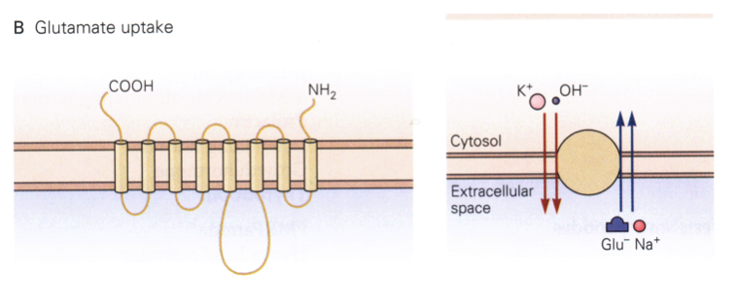
Getting Glutamate into Neuron:
Glucose Transporter

Slide 23
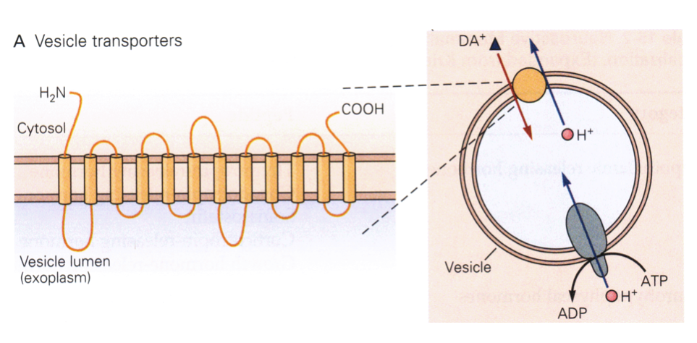
Packaging classical NTs into vesicles

Slide 24
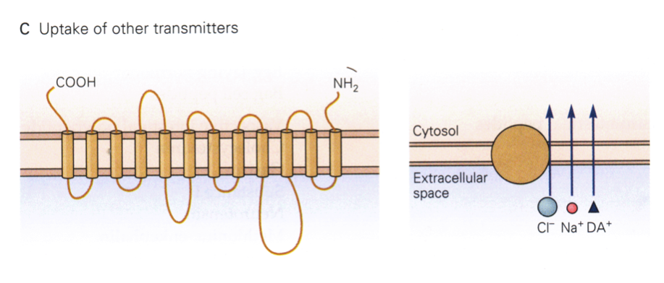
Clearing classical NT from the synapse
Dopamine, serotonin and other neurotransmitters are removed from synapse by specific transporter molecules

Slide 25
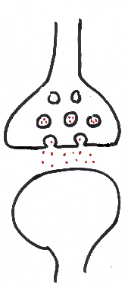
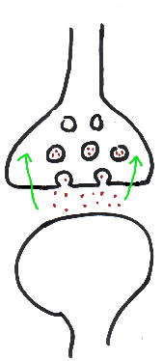
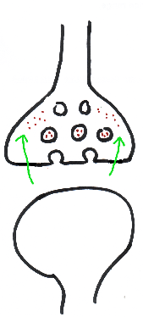
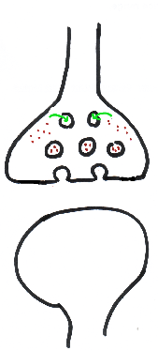
Transporters clear synapse and recycle NT;
re-uptake inhibitors prolong synaptic action
Release
from vesicles
Reuptake by transporters
Repackaging by
vesicular transporters

Slide 26
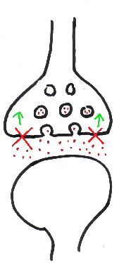
Transporters clear synapse and recycle NT;
re-uptake inhibitors prolong synaptic action
cocaine blocks
DA transporter
ecstasy, prozac blocks
5HT transporter
Block by Reuptake Inhibitor
Normal Reuptake

Slide 27
Neuropeptides
Small peptides, from 4 amino acids to ~100 amino acids.
Coded for by genes, synthesized by ribosomes (like other proteins).
Signal peptide sequence directs neuropeptide into endoplasmic reticulum, Golgi apparatus, and into secretory vesicles.
In neurons, neuropeptides are co-localized and released with classical neurotransmitters.
Many neuropeptides also serve as hormones secreted by glands into the blood.
Act on G-protein coupled receptors; slow, long-lasting effect on target cells

Slide 28
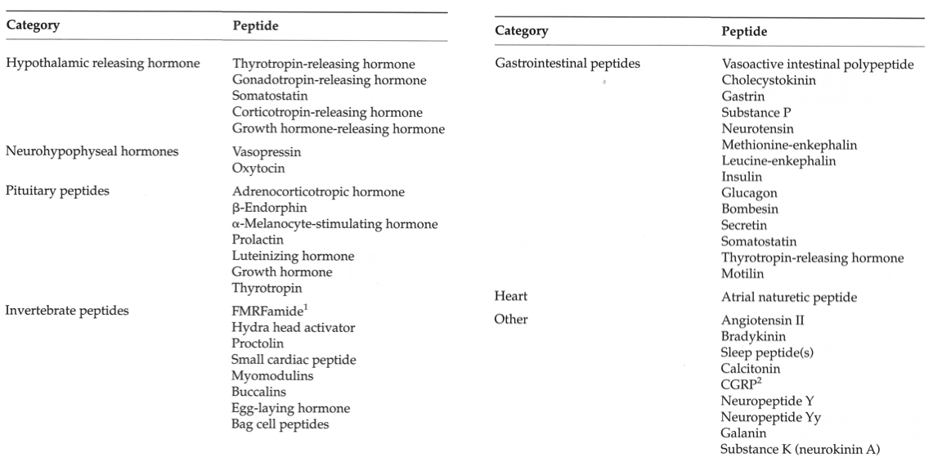
Neuropeptides -- small chains of amino acids synthesized and released by neurons
more variety, because combination of 4 to 100 a.a.
(similar variety of receptors!)

Slide 29
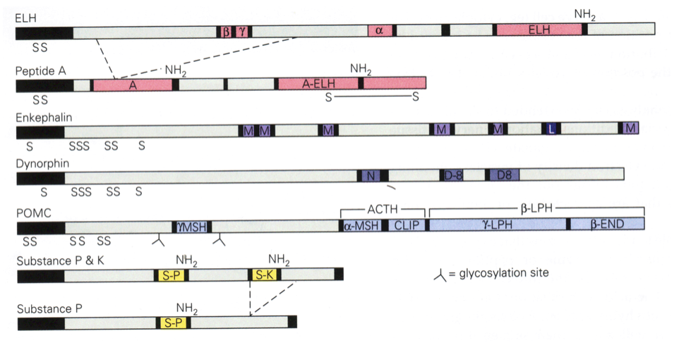
Neuropeptides are cleavage products of prepropeptides

Slide 30
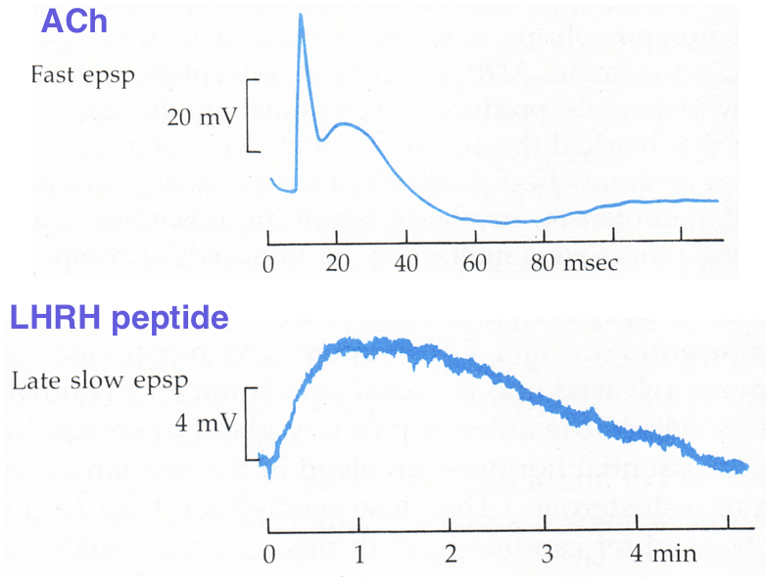
Neuropeptides & classical NTs in same synapse, but different effects via different receptors
ACh
LHRH
ACh
receptor
LHRH
receptor

Slide 31
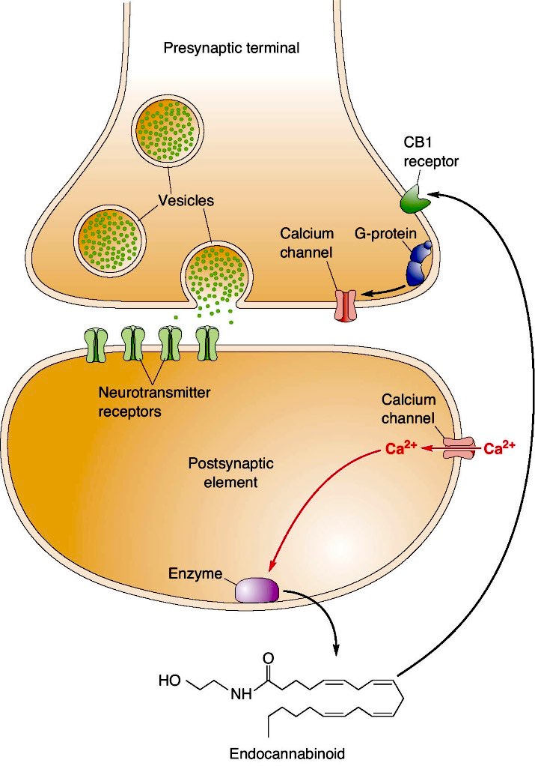
Retrograde Neurotransmitters
transmitters synthesized in postsynaptic neuron,
then float back across synapse to presynaptic neuron
small gas molecules
lipid-derived molecules
endocannibinoids & cannibinoid receptors:
most common receptors in brain

Slide 32
How to detect Neurotransmitters
Classical
small molecules
Neuropeptides
histochemical
Neurotransmitter itself
Neuropeptide itself
proteins
uptake or enzymes
Neuropeptide itself
mRNA
enzyme, uptake gene expression
Neuropeptide gene expression

Slide 33
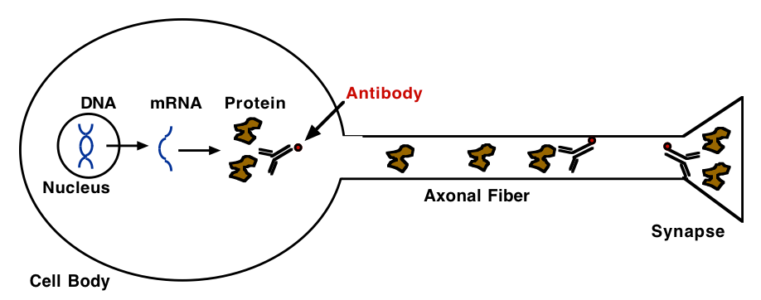
use immunohistochemistry to detect chemicals, proteins

Slide 34
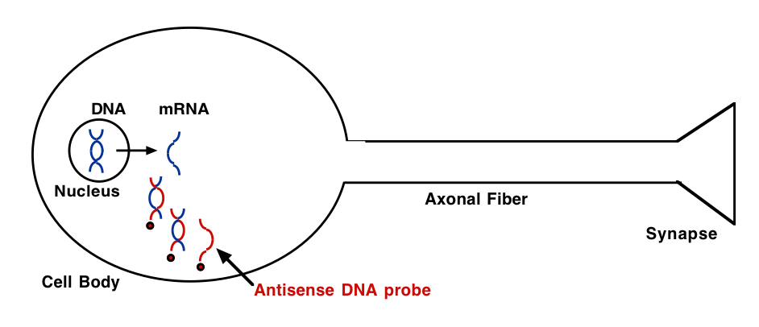
use in situ hybridization to detect mRNA for enzymes, transporters, or neuropeptides

Slide 35
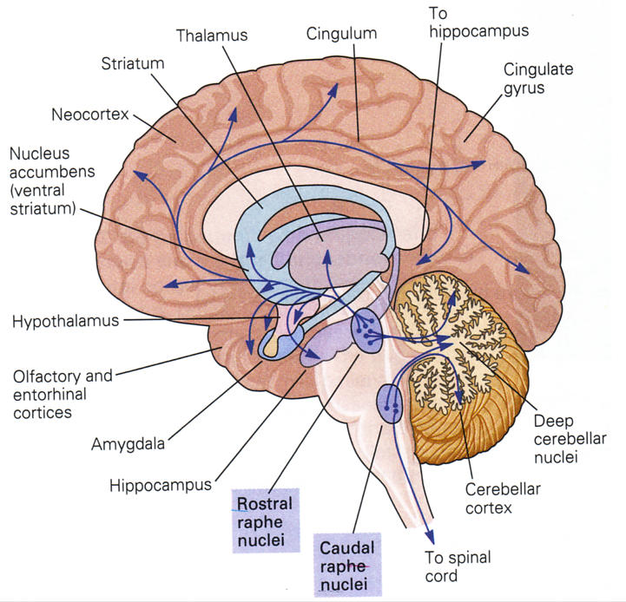
Example: Visualizing Serotonin

Slide 36
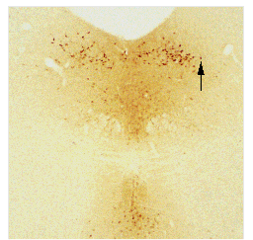
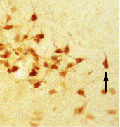
Cell bodies that synthesize serotonin
antibodies that bind serotonin

Slide 37
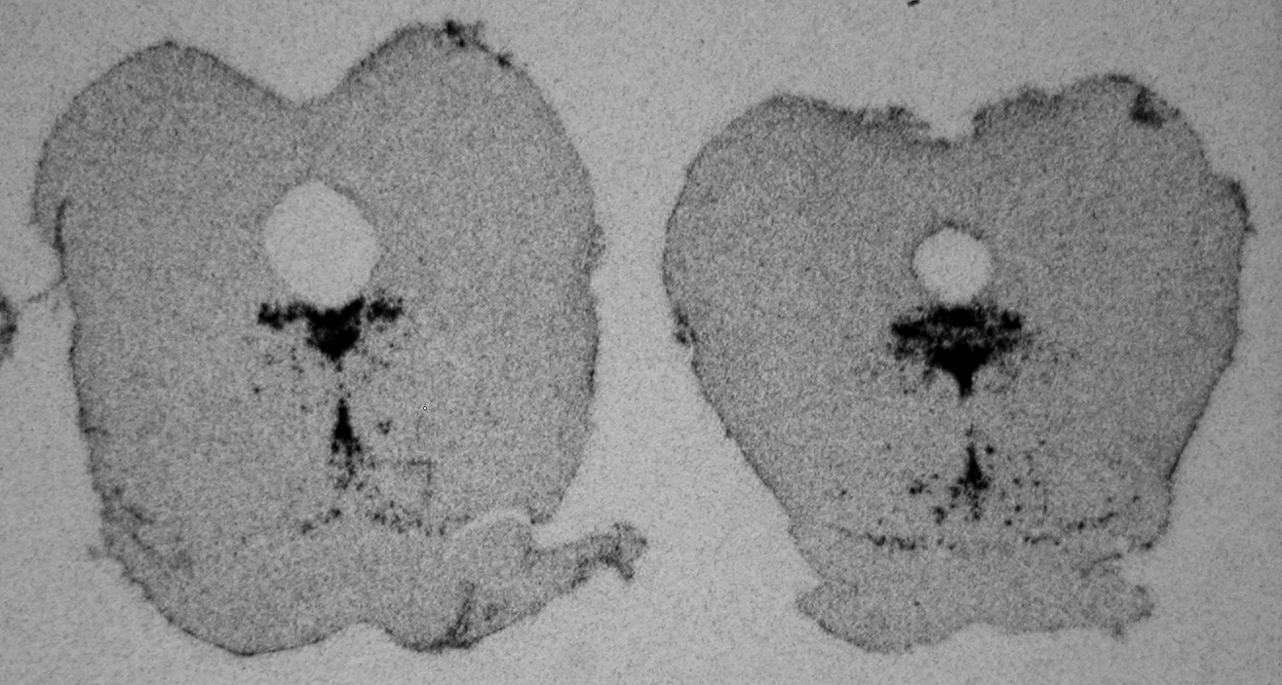
Cell bodies that express mRNA for serotonin transporter
radioactive DNA probe that sticks to 5HT-T RNA

Slide 38
Neurotransmitters and Receptors
1. Ligand-Gated Ion Channels
Neurotransmitter binds to channel protein, causing it to open and allow ions to move into the cell.
2. G-Protein Coupled Receptors
Neurotransmitter binds to receptor protein, which activates a complex of G-proteins (interact with GTP).
Activated G-proteins
i. can interact with ion channels in membrane to change Vm
ii. can activate second messenger systems like adenylate cyclase to raise cAMP levels in the cytoplasm for slower, intracellular signaling.
iii. G-proteins can be stimulatory (Gs -> more cAMP) or inhibitory (Gi -> less cAMP)
A single neurotransmitter can act on multiple types of receptors.
Type of receptor determines the response of the postsynaptic target cell.
So one neurotransmitter can have opposite effects on 2 different postsynaptic cells, if each postsynaptic cell has a different receptor type.

Slide 39
Terminology:
Ion Channel
Receptor
G-Protein
Coupled Receptor

Slide 40
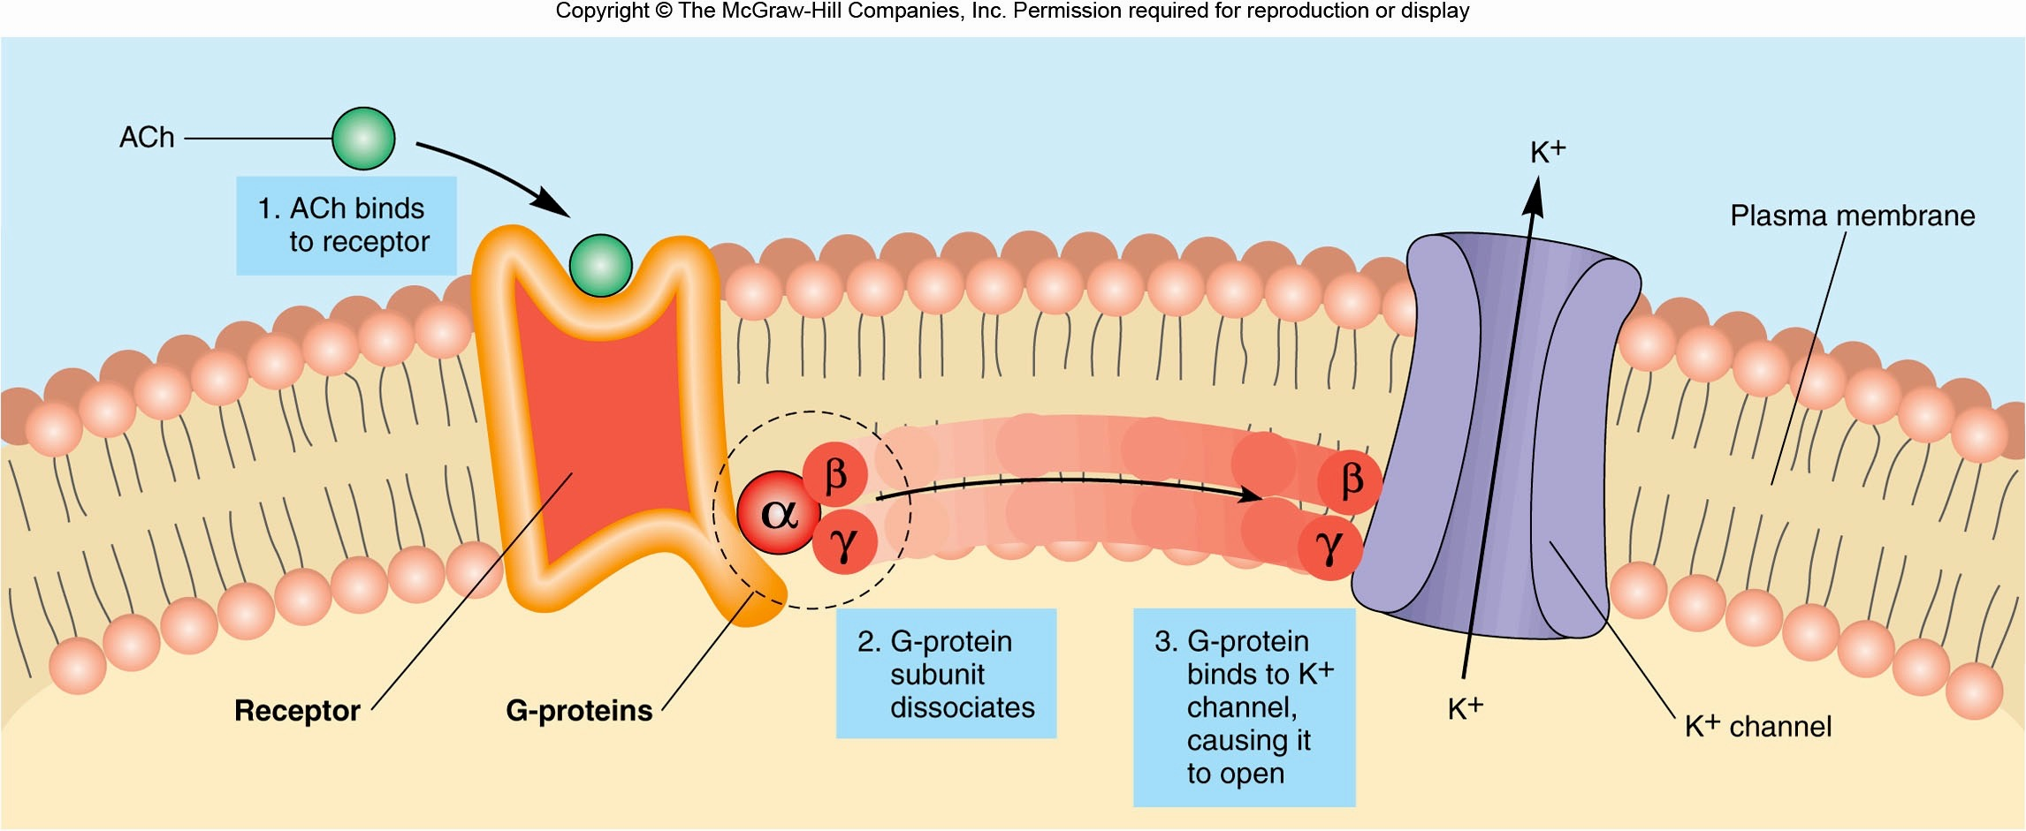
G-Proteins can directly affect ion channels
Fox Figure 7.27

Slide 41
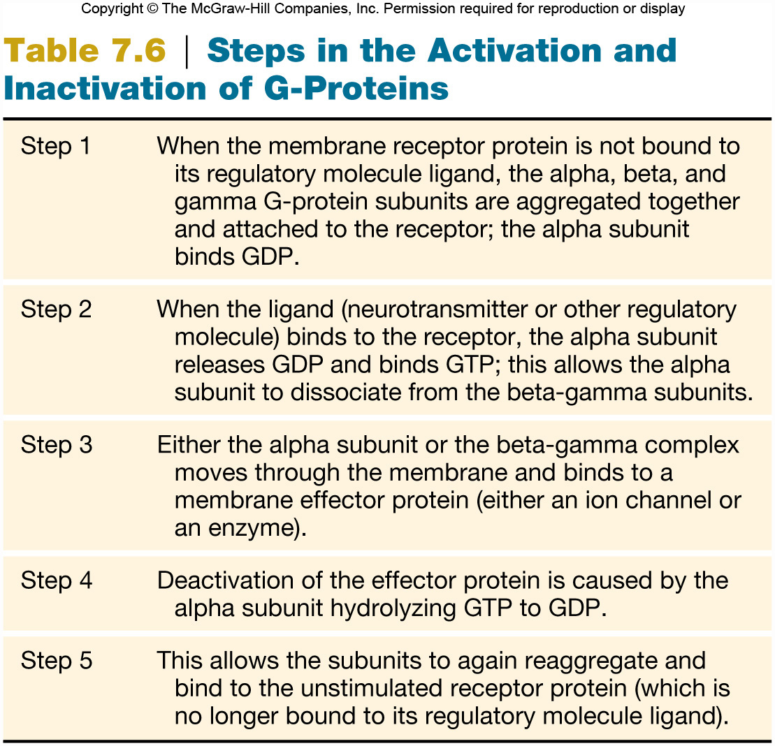
Fox Table 7.6

Slide 42
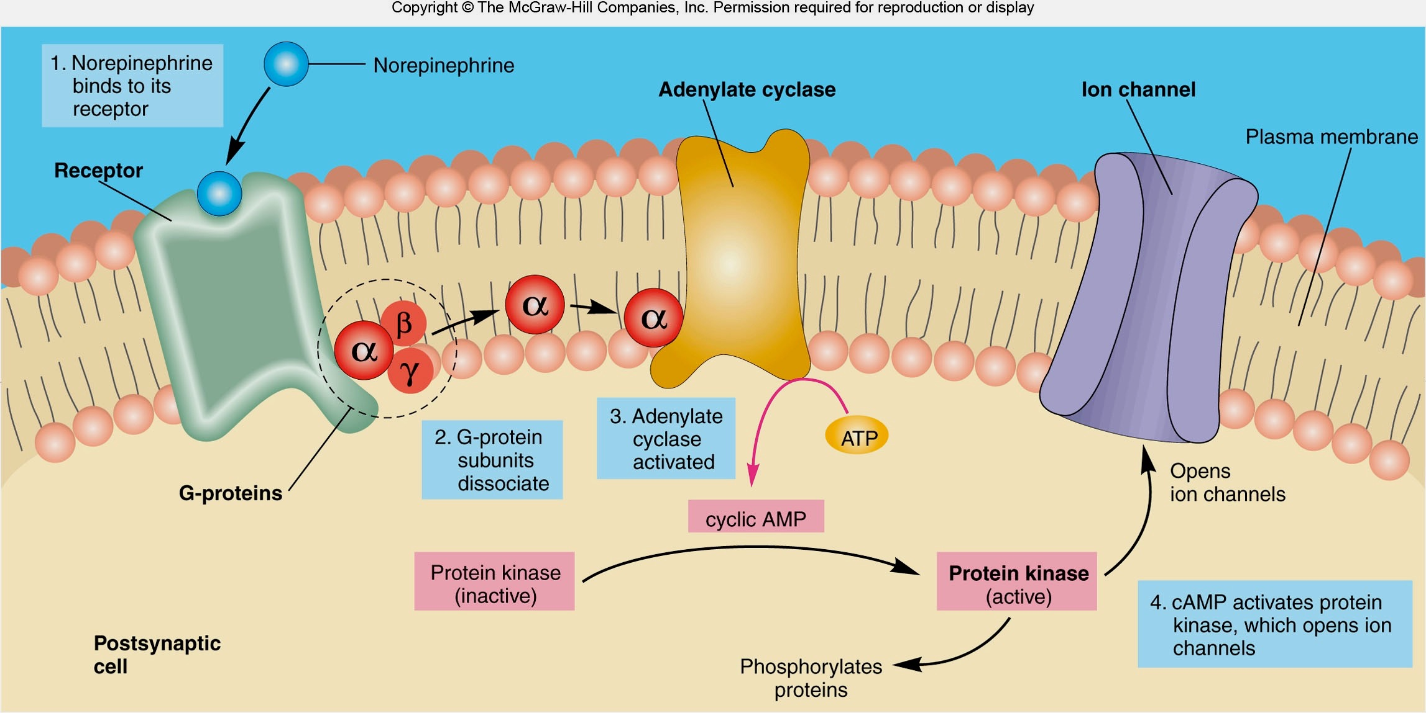
G-Proteins can affect second messenger signaling
(e.g. cAMP levels in the cytoplasm)
Text
Fox Figure 7.31

Slide 43
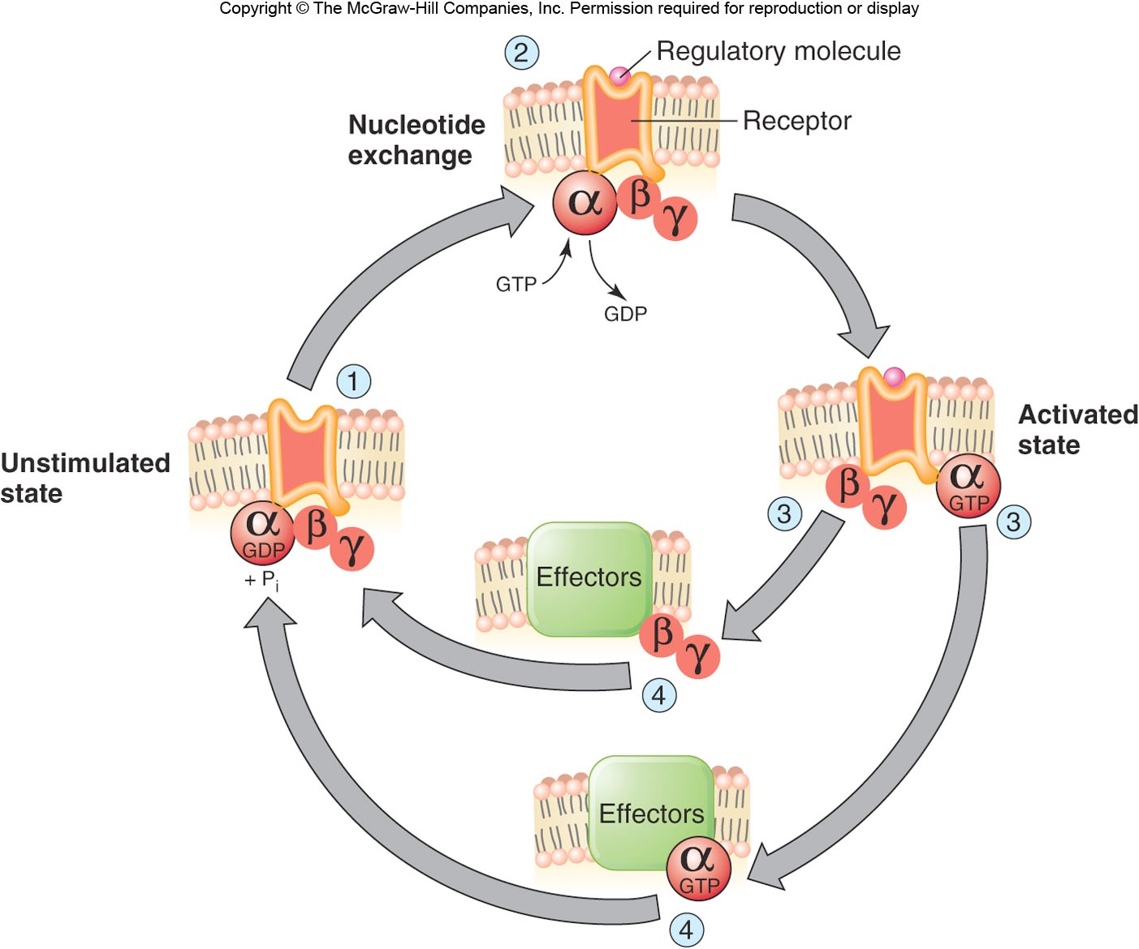
Figure 6.31

