Slide 1
Resting Membrane potential (V_{m}) or RMP
Many cells have a membrane potential (Vm) that can be measured from an electrode in the cell with a voltmeter.
neurons, muscle cells, heart cells, endocrine cells...
V_{m} = resting membrane potential (RMP)
= electrical potential generated by separation of charges
= voltage across the membrane
= V_{inside} - V_{outside}
Cells have an unequal distribution of charge across their membrane:
more postiive charges on the outside; more negative charges on the inside.
Charge separation is caused by movement of ions in and out the cell.
Ions are moved by chemical diffusion down concentration gradients and by electrical attraction, and by active transport (e.g. Na+/K+ pump.)
Concentration of ions inside and outside reaches equilibrium (stays constant) due to equilibrium potential.

Slide 2
http://www.youtube.com/watch?v=k48jXzFGMc8

Slide 3
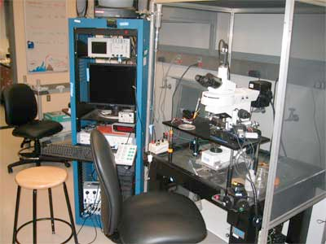

Slide 4
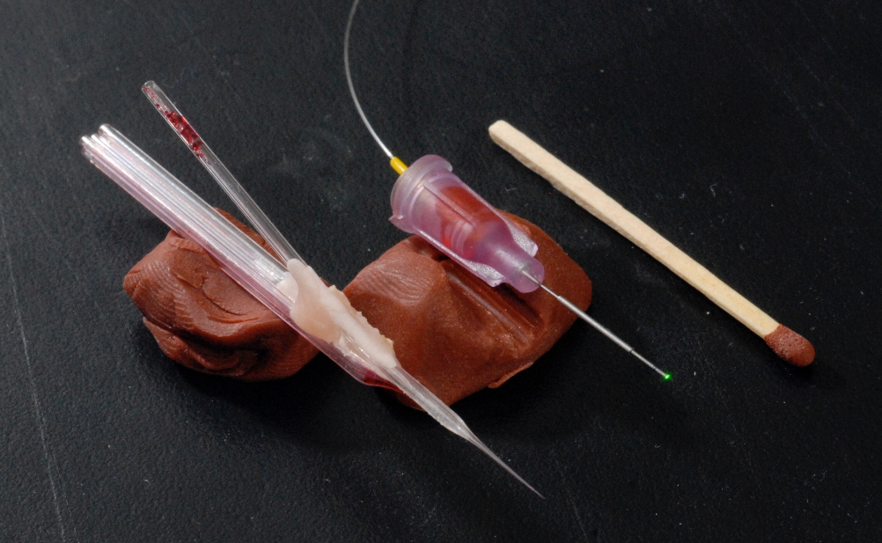
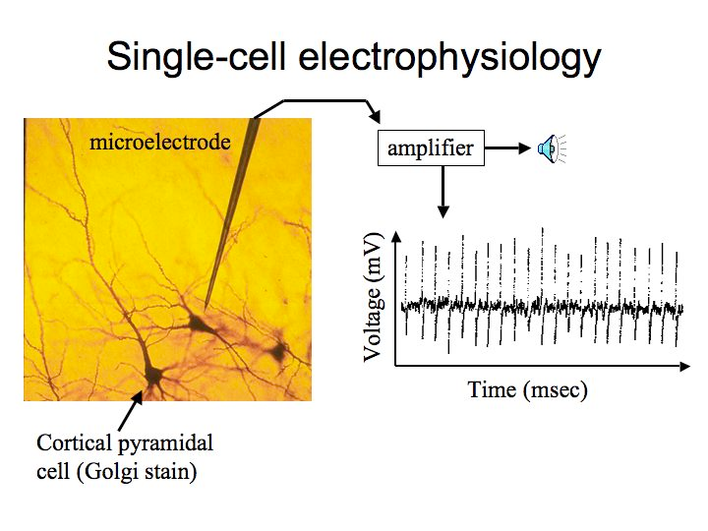

Slide 5
http://www.youtube.com/watch?v=AEY-t9hyNBI

Slide 6
Ion Channels & Membrane Potential
Neurons need to send signals quickly over long distances.
They utilize waves of electrical current across their membranes.
This requires that they maintain a differential distribution of charge between the inside and outside of the neuron,
and that they can switch a cross-membrane current on and off to make the signal.

Slide 8
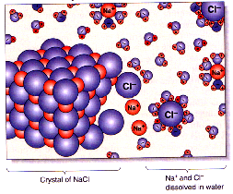
Major ions in neuroscience:
Na+, K+, Cl-, Ca++, & protein anions (A-)

Slide 9
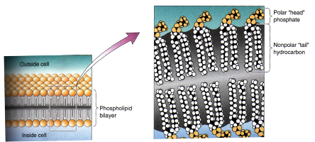
outside
[Na+][K+]
[Na+][K+]
inside

Slide 10
Na+/K+ Transporter
Ion | Outside (mM) | Inside (mM)
K⁺ | 5 | 100
Na⁺ | 150 | 15
Na ions slowly leak into cell down concentration gradient and attracted by negative charges of the cytoplasm.
Neuron actively maintains Na and K concentrations by exchanging:
3 Na ions out for 2 K ions in for every 1 ATP molecule.

Slide 11
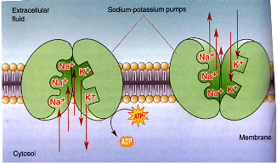
[Na+][K+]
[Na+][K+]

Slide 12
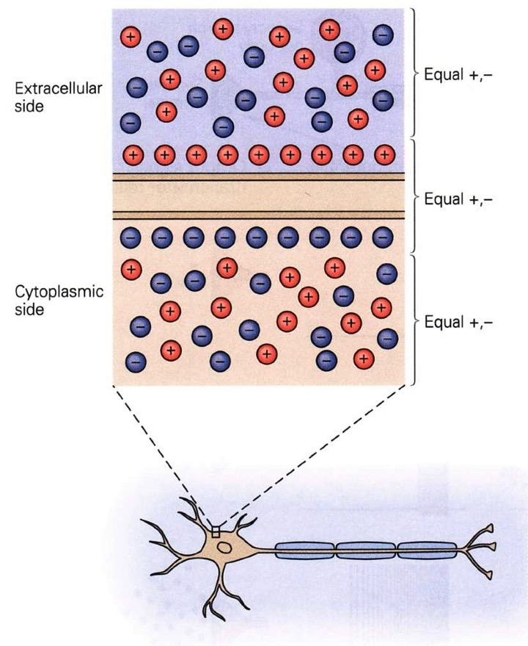
Unequal charges across the cell membrane

Slide 13
Membrane potential (V_{m})
V_{m} = resting membrane potential
= electrical potential generated by separation of charges
= voltage across the membrane
= V_{inside} - V_{outside}

Slide 14
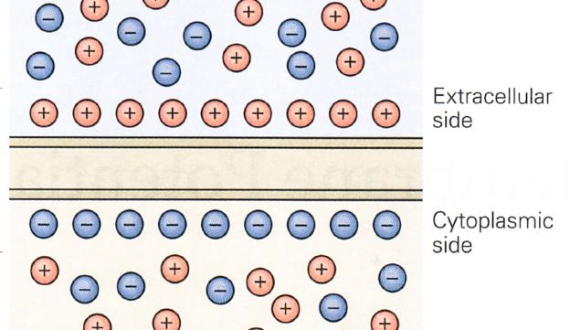
Membrane potential (V_{m})
V_{m} = V_{in} - V_{out}
(V_{out} = 0 mV by definition)
V_{m} = V_{in} - 0
(more negative ions inside)
V_{m} = -60 to -70 mV
V_{out} = 0
V_{in} = -60 mV

Slide 15
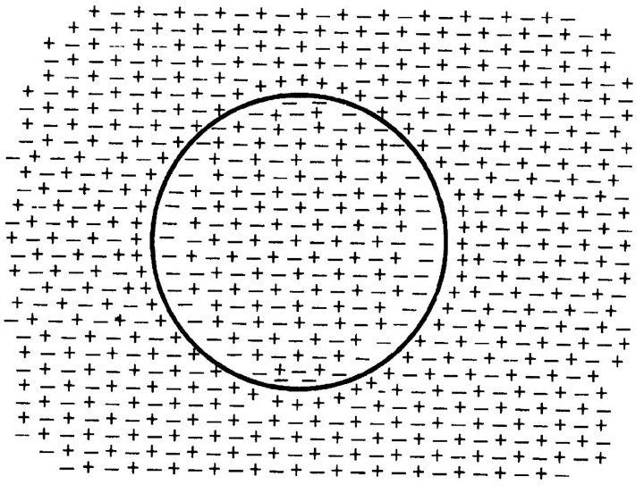
Membrane potential is caused by small number of total ions

Slide 16
Membrane potential is caused by small number of total ions

Slide 17
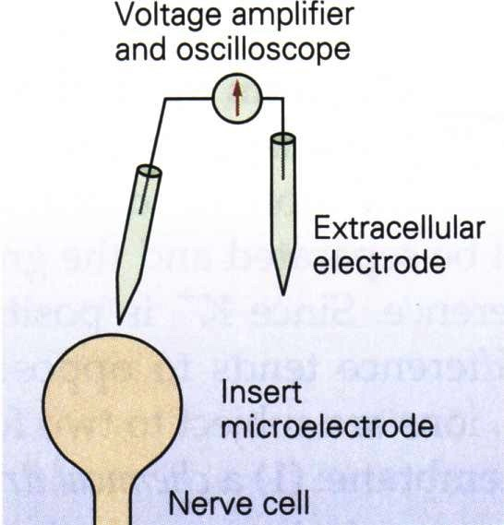
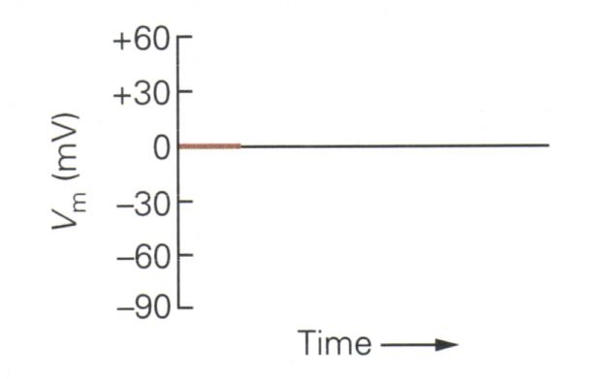
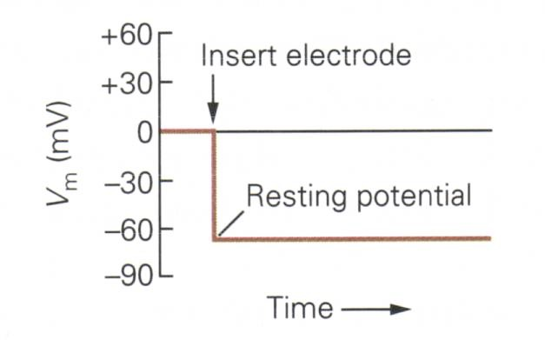
Measuring V_{m}

Slide 18
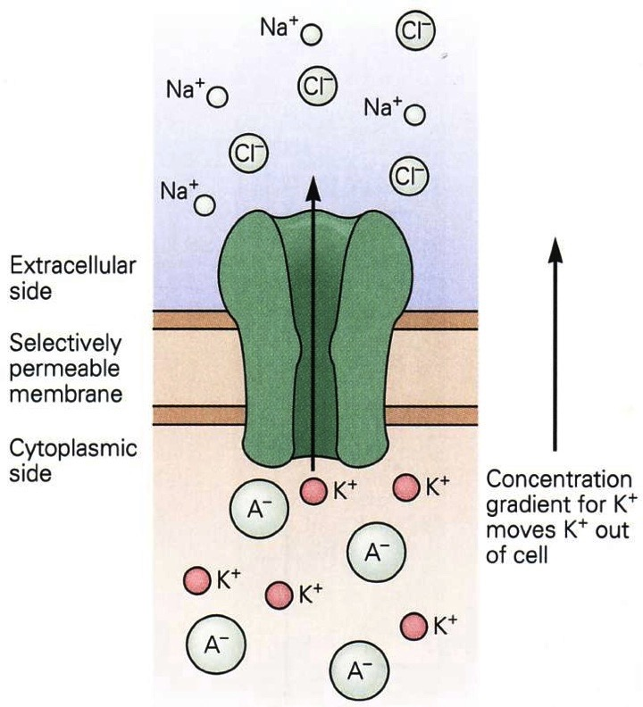
How to establish the membrane potential?

Slide 19
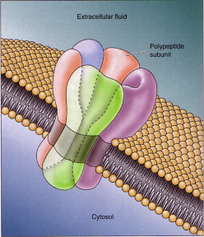
Ion Channels:
proteins that span the membrane and allow ions to diffuse across the phospholipid bilayer

Slide 20
Equilibrium Potential for an ion
Each ion species feels two forces pulling on it:
chemical driving force: depends on concentration gradient across membrane
electrical driving force: depends on electrical potential difference across membrane

Slide 21
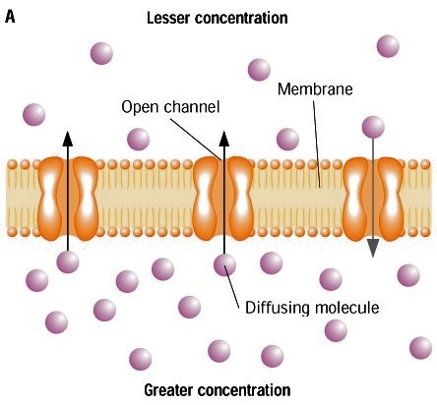
Force on ions:
Diffusion down concentration gradient

Slide 22
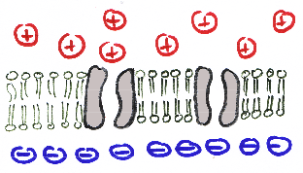
Force on ions:
Pulled toward opposite charge

Slide 23
Equilibrium Potential for an ion
Each ion species feels two forces pulling on it:
chemical driving force: depends on concentration gradient across membrane
electrical driving force: depends on electrical potential difference across membrane
these forces can act in same direction or opposite directions across the membrane

Slide 24
For potassium, chemical and electrical forces are in opposite directions

Slide 25
For potassium, chemical and electrical forces are in opposite directions
Electrical
gradient for K+
pulls K+ into
the cell

Slide 26
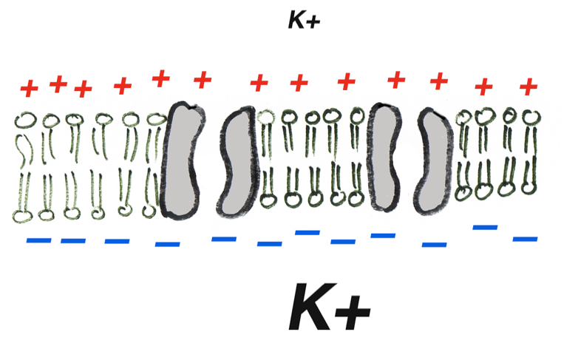
Electrochemical Forces on Potassium K⁺ Ion
chemical
electrical
outside neuron
inside neuron

Slide 27
Electrochemical Forces on Sodium Na⁺ Ion
chemical
electrical
outside neuron
Na+
inside neuron
Na+

Slide 28
Equilibrium Potential for an ion
Each ion species feels two forces pulling on it:
chemical driving force: depends on concentration gradient across membrane
electrical driving force: depends on electrical potential difference across membrane
these forces can act in same direction or opposite directions across the membrane
the electrical potential that balances the concentration gradient is called the equilibrium potential.

Slide 29
Equilibrium Potential for an ion
If there are open channels for an ion, the electrical and chemical driving forces will try to force the ions to move across the membrane.
the ion will move across the membrane until the change in electrical charge causes the cell’s V_{m} to reach the ion’s equilibrium potential.

Slide 30
Equilibrium Potential for one ion across the membrane
https://www.youtube.com/watch?v=4kx9_0YwShE

Slide 31
Distribution of Ions in Mammalian Neurons
Ion | Outside (mM) | Inside (mM) | Ratio Out : In | E_{ion}
K⁺ | 5 | 100 | 1:20 | ?
Na⁺ | 150 | 15 | 10:1 | ?
Ca⁺⁺ | 2 | 0.0002 | 10,000:1 | ?
Cl⁻ | 150 | 15 | 10:1 | ?

Slide 32
Calculating the Equilibrium Potential
Given the concentrations of ions inside and outside of a neuron, we can calculate its Equilibrium Potential using the Nernst Equation

Slide 33
Nernst Equation
E_{ion} is the “equilibrium potential” for a single permeant ion
E_{ion} (mV) = RT / zF • log ([ion]_{out} / [ion]_{in})
R = gas constant
T = temperature (kelvin)
z = valence
F = Faraday constant
E_{ion} (mV) = 62 / charge • log ([ion]_{out} / [ion]_{in})
at 37 C

Slide 34
Distribution of Ions in Mammalian Neurons
Ion | Outside (mM) | Inside (mM) | Ratio Out : In | E_{ion}
K⁺ | 5 | 100 | 1:20 | ?
Na⁺ | 150 | 15 | 10:1 | ?
Ca⁺⁺ | 2 | 0.0002 | 10,000:1 | ?
Cl⁻ | 150 | 15 | 10:1 | ?

Slide 35
Nernst Equation for K⁺
E_{ion} (mV) = 62 / charge • log ([ion]_{out} / [ion]_{in})
E_{K}⁺ (mV) = 62 / +1 • log (5 mM / 100 mM)
= 62 / +1 • log (.05)
= 62 / +1 • -1.3
= –80 mV

Slide 36
Nernst Equation for Na⁺
E_{ion} = 62 / charge • log ([ion]_{out} / [ion]_{in})
E_{Na}⁺ = 62 / +1 • log (150 mM / 15 mM)
= 62 / +1 • log (10)
= 62 / +1 • log (1)
= +62 mV

Slide 37
Nernst Equation for Cl⁻
E_{ion} = 62 / charge • log ([ion]_{out} / [ion]_{in})
E_{Cl}– = 62 / –1 • log ( 100 mM / 10 mM)
= 62 / –1 • log ( 10 )
= 62 / –1 • 1
= – 62 mV

Slide 38
Nernst Equation for Ca++
E_{ion} = 62 / charge • log ([ion]_{out} / [ion]_{in})
E_{Ca++} = 62 / +2 • log ( 2 mM / .0002 mM)
= 62 / +2 • log ( 10,000)
= 62 / +2 • 4
= 123 mV

Slide 39
Nernst Equation
E_{K}⁺ = 62 / +1 • log (5 mM / 125 mM)
= –80 mV
E_{Na}⁺ = 62 / +1 • log (150 mM / 15 mM)
= +62 mV
E_{Cl}– = 62 / –1 • log ( 100 mM / 10 mM)
= –62 mV
E_{Ca++} = 62 / 2 • log ( 2 mM / .0002 mM)
= 123 mV
But how to calculate overall membrane potential?

Slide 40
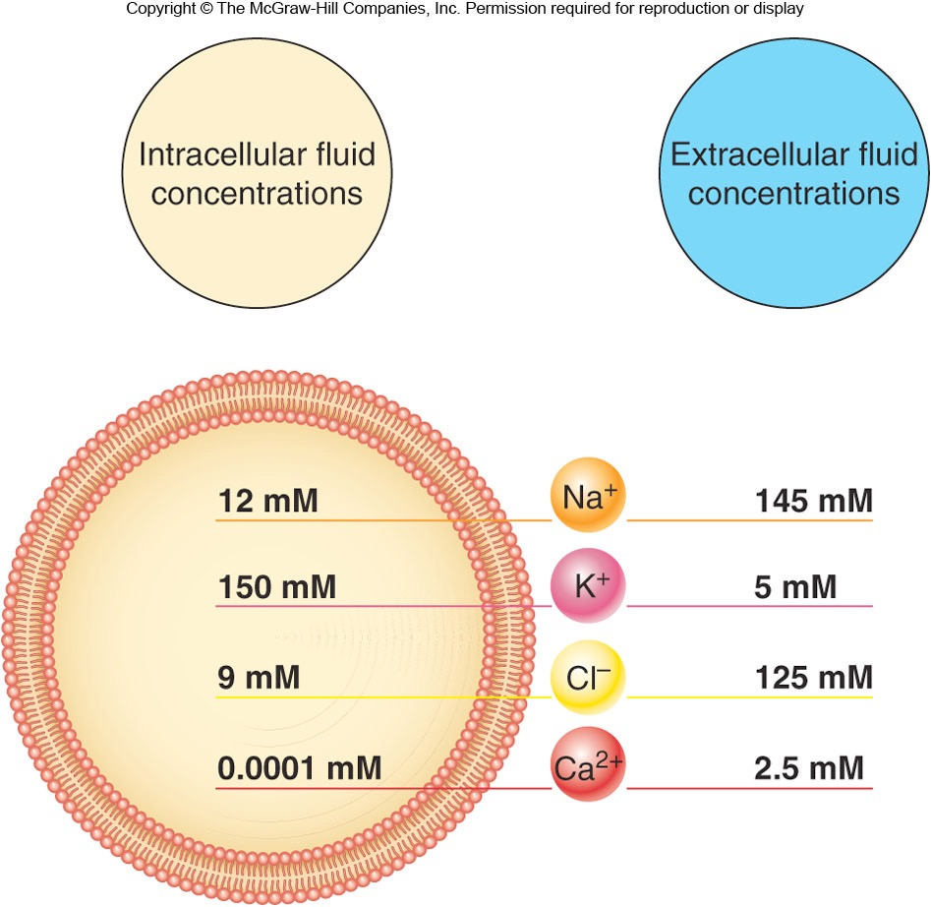
Membrane Potential (Vm) for a cell:
Each ion contributes to overall membrane potential
Equilibrium Potentials
+62 mV
-80 mV
-62 mV
+123 mV
Fox Figure 6.26

Slide 41
Distribution of Ions in Mammalian Neurons
Ion | Outside (mM) | Inside (mM) | Ratio Out : In | E_{ion} _{(mV)}
K⁺ | 5 | 100 | 1:20 | -80
Na⁺ | 150 | 15 | 10:1 | +62
Ca⁺⁺ | 2 | 0.0002 | 10,000:1 | 123
Cl⁻ | 150 | 15 | 10:1 | -62
But how to calculate overall membrane potential?

Slide 42
Equilibrium Potential for an ion
If there are open channels for an ion, the electrical and chemical driving forces will try to force the ions to move across the membrane.
the ion will move across the membrane until the change in electrical charge causes the cell’s V_{m} to reach the ion’s equilibrium potential.
Because the cell is selectively permeable to ions, some ions can move across the membrane , while ions with closed ion channels cannot move across the membrane.

Slide 43
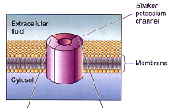
Protein structure of K+ channel makes it selective for K+
(i.e. Na+, Cl-, Ca++ can’t get through)

Slide 44
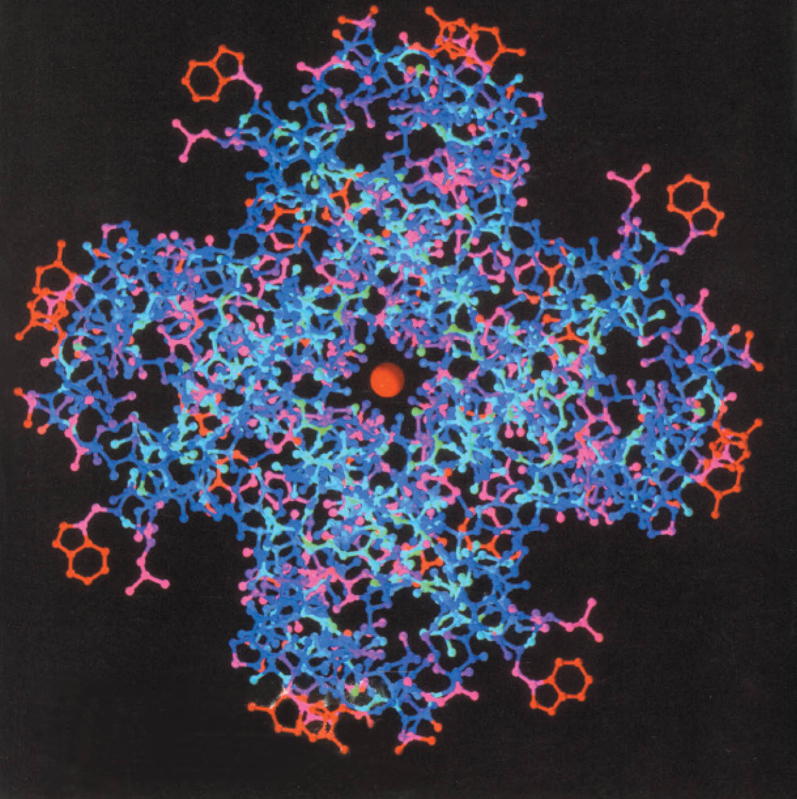
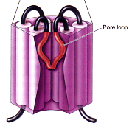
Pore Loop

Slide 45
Ion flux
number of ions that are crossing the membrane
ion flux = (electrical force + chemical force)
x membrane permeability for that ion
In the resting neuron,
Lots of open K⁺ channels, so K⁺ flux can be large.
Very few open Na⁺ channels, so Na⁺ flux is low.
Neuron actively controls concentrations of Na⁺ & K⁺
So, V_{m} lies in between Equilibrium Potentials of K⁺ and Na⁺

Slide 46
Permeability of Ions in Mammalian Neurons
Outside Inside (mM) E_{ion} Permeab.
K⁺ 5 125 -81 1.0
Na⁺ 150 15 +62 0.04
Cl⁻ 100 10 -62 0.045
Because K+ has the highest permeability, it has the highest flux and so contributes the most to the overall membrane potential.

Slide 47
Goldman Equation
Goldman Equation is the compromise potential reached
accounting for each permeant ion.
P_{K}[K⁺]_{o} + P_{Na}[Na⁺]_{o} + P_{Cl}[Cl⁻]_{i}
V_{membrane =} 62 log _______________________________________
P_{K}[K⁺]_{i} + P_{Na}[Na⁺]_{i} + P_{Cl}[Cl⁻]_{o}
P_{X}= relative permeability of ion X
[X]_{i} = concentration of X inside cell
[X]_{o} = concentration of X outside cell

Slide 48
Goldman Equation
1[5]_{o} + .04[150]_{o} + .05[10]_{i}
V_{m}= 62 log _________________________________________
1[125]_{I} + .04[15]_{i} + .05[100]_{o}
V_{m}= -65 mV
V_{m} approaches the Equilibrium Potential of
the most permeable ion.

Slide 49
Distribution of Ions in Mammalian Neurons
Outside Inside (mM) E_{ion} Permab.
K⁺ 5 125 -80 1.0
Na⁺ 150 15 -62 0.04
Cl⁻ 100 10 -62 0.045
V_{m}= -65 mV

Slide 50
Change of Concentration leads to change of V_{m}
Outside Inside (mM) E_{ion} Permab.
K⁺ 150 150 0 1.0
Na⁺ 150 15 +62 0.04
Cl⁻ 100 10 -62 0.045
V_{m} = +0 mV

Slide 51
Change of Permeability leads to change of V_{m}
Outside Inside (mM) E_{ion} Permab.
K⁺ 5 125 -80 1.0
Na⁺ 150 15 -62 20
Cl⁻ 100 10 -62 0.045
V_{m} = +49 mV

Slide 52
Changing the Membrane Potential
https://www.youtube.com/watch?v=qNvtlW8LPRw

