Slide 1
PCB 4843
Fundamentals of Neuroscience
Instructor:
Tom Houpt, email: houpt@bio.fsu.edu
Durba Mukherjee, email: dmukherjee@bio.fsu.edu
Canvas:
Lectures will be posted at least the day before class under “Course Files”
Problem sets will be posted under “assignments”

Slide 2
Lecture 1: Overview of the Nervous System
Navigational Terms
Supracellular Features of Vertebrate Nervous System
Pharmacological Approach to the Nervous System
Levels of Analysis of A Neuron
Lecture 2: Review of Neurons & Cellular Biology

Slide 3
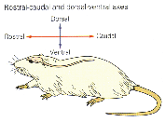
3 Spatial Axes of the rat nervous system
Quadraped:
rostral -- towards nose
caudal -- towards tail
dorsal -- towards back
ventral -- towards belly
medial -- toward center
lateral -- toward side
lateral
medial

Slide 4
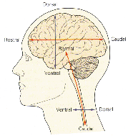
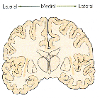
3 Spatial Axes of the human nervous system
Human:
anterior -- towards face (rostral in head, ventral in body)
posterior -- towards back (caudal in head, dorsal in body)
superior -- toward head (dorsal in head, rostral in body)
inferior -- toward feet (ventral in head, caudal in body)
medial -- toward center
lateral -- toward side
Superior
Anterior
Posterior
Inferior

Slide 5
Supracellular Features of Vertebrate Nervous System
Centralized brain and spinal cord
Dorsal placement and lateral symmetry
Peripheral nervous system
Segmentation of nervous system
Central vs. Peripheral nervous systems

Slide 6
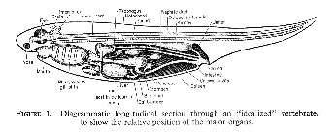
Vertebrate Body Plan
Notochord/Vertebrae along dorsal spinal cord

Slide 7
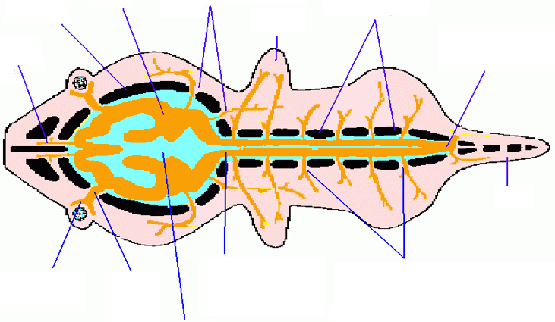
Simplified Plan of the Nervous System of a Generalized Vertebrate
Cranial nerves passing thru foramina in base of skull
Brain
Arches of
vertebrae
Skull
limb
Olfactory
nerve
caudal
spinal cord
tail
Spinal cord
passing thru
foramen magnum
Retina
of eye
Optic
nerve
Spinal nerves passing
thru intervertebral foramina
Neurocoele

Slide 8
Vertebrate Central Nervous System
cerebrum
cerebellum
Dorsal
brainstem
spinal cord
Rostral
Caudal
GI tract
Ventral

Slide 9
Cerebral Ventricles and Central Canal:
Spaces within the brain and spinal cord filled with cerebral spinal fluid (CSF)
lateral ventricles
4th ventricle
central canal
3rd ventricle
cerebral
aqueduct
GI tract

Slide 10
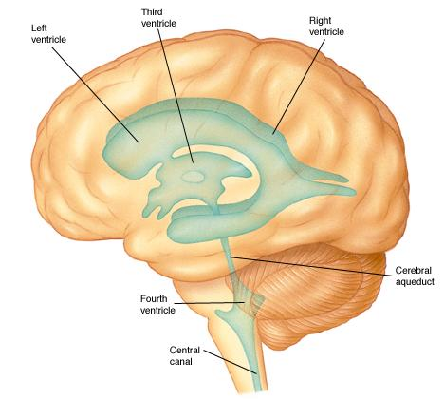

Slide 11
cerebellum
Dorsal
cerebrum
brainstem
spinal cord
Rostral
Caudal
GI tract
Ventral

Slide 12
Spinal Cord, Brainstem, Cerebellum, Cerebrum
CNS structures common to all vertebrates (along with optic tectum and olfactory bulb)

Slide 13
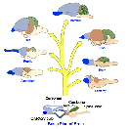
Spinal Cord, Brainstem, Cerebellum, Cerebrum
CNS structures common to all vertebrates (along with optic tectum and olfactory bulb)

Slide 14
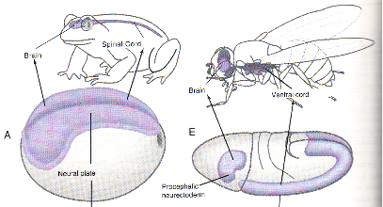
Dorsal placement of Vertebrate CNS
vs. Ventral placement of Invertebrates

Slide 15
Bilateral Symmetry
a result of symmetrical development of Nervous System from midline
Frog
Fly
Lateral
Medial
Lateral
Lateral
Medial
Lateral

Slide 16
Bilateral Symmetry is not a given...

Slide 17
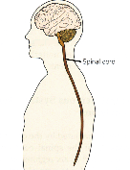
7 parts of the Mammalian Central Nervous System
1. Spinal cord
from base of skull to lumbar vertebra
sensory info from trunk & limbs
voluntary & reflex & autonomic motor output

Slide 18
1. Spinal Cord
DORSAL (POSTERIOR)
sensory input
dorsal horn
ventral horn
motor output
central canal
VENTRAL (ANTERIOR)

Slide 19
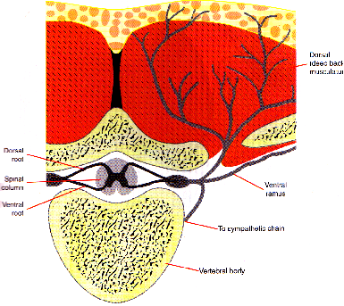

Slide 20
2-3. Brainstem: Medulla, Pons, Midbrain

Slide 21
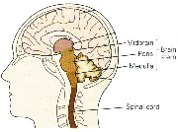
2. Medulla (core)
“Autonomic spinal cord”
Blood pressure, breathing, feeding and GI functions
& reflexes
3. Pons (bridge)
Relays from cortex
& spinal cord to cerebellum
Sleep
4. Midbrain
Final limb movements
(site of Parkinsons),
eye movements

Slide 22
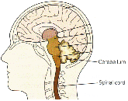
5. Cerebellum (little brain)
Motor learning
Motor coordination
Posture & eye movements

Slide 23
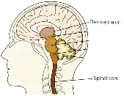
6. Diencephalon
1. Thalamus (chamber)
Relay & modulatory of sensory input to the cortex
2. Hypothalamus
(under the thalamus)
homeostasis,
reproduction, primary behaviors

Slide 24
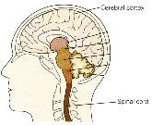
7. Cerebral hemispheres
a. Cerebral Cortex (bark)
perception, cognition, movement
b. Basal ganglia
movement
c. Amygdala (almond)
emotions
d. Hippocampus (sea horse)
memory
two hemispheres connected by corpus callosum

Slide 25
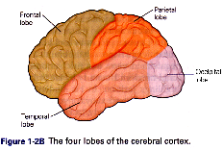
Gyrus (fold)
Sulcus (groove)

Slide 26
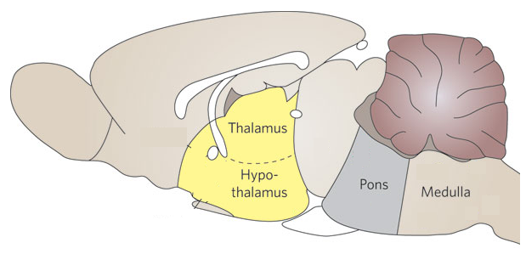
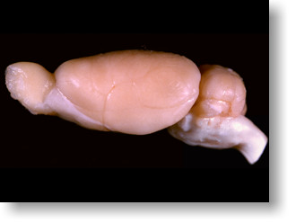
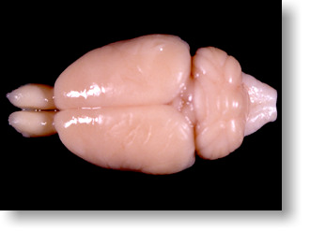
Sagittal rat brain
Cortex
Olfactory
bulb
Midbrain
Cerebellum

Slide 27
Segmentation of the Nervous System
cerebrum
cerebellum
brainstem
spinal cord
GI tract

Slide 28
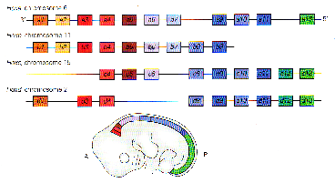
Segmentation of the Spinal Cord
Functional result of developmental plan

Slide 29
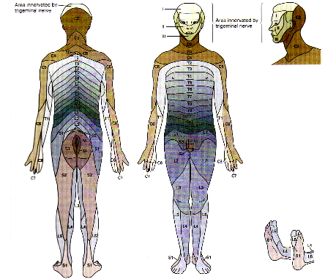
One Dorsal root ganglion approx. for each vertebra: (DRG = cell bodies of spinal sensory neurons)
receptive fields of one DRG = dermatome

Slide 30
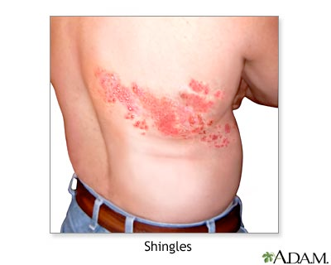
herpes varicella zoster virus
Chicken Pox
Shingles
Shingles, or herpes zoster, is caused by the same virus that causes chickenpox. The virus can lie dormant in the body for many years and re-emerge as shingles. Shingles appear as a painful rash. It consists of red patches of skin with small blisters (vesicles) that look very similar to early chickenpox. Shingles usually clears in 2 to 3 weeks and rarely recurs.
http://en.wikipedia.org/wiki/File:Child_with_chickenpox.jpg
https://health.google.com/health/ref/Herpes+zoster

Slide 31
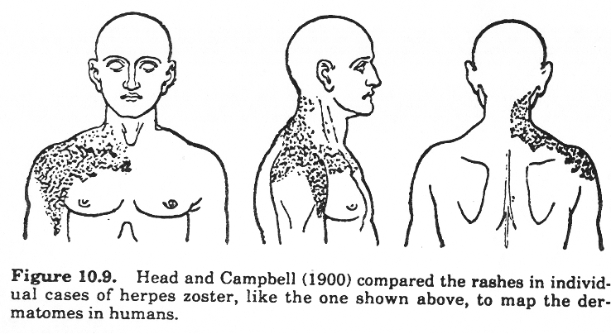
Infection by neural virus that lives in DRG cells: herpes zoster (shingles or chicken pox)

Slide 32
Segmentation of the Nervous System
cerebrum
cerebellum
brainstem
spinal cord
ganglion of sensory neurons for one spinal segment
initial infection
(chicken pox)
re-emergence
(shingles)

Slide 33
One Dorsal root ganglion approx. for each vertebra: (DRG = cell bodies of spinal sensory neurons)
receptive fields of one DRG = dermatome

Slide 34
Peripheral Nervous System:
Neurons and nerve fibers outside the brain and spinal cord
motor neurons
sensory ganglion
autonomic ganglion
sensory nerve
autonomic nerve
motor nerve
GI tract
enteric NS

Slide 35
Peripheral nervous system
(outside brain and spinal cord)
Motor nerves that from brain and spinal cord to run muscles
Sensory nerves with cell bodies in periphery
Somatic nervous system:
nerves that allow us to consciously sense and move our body
Autonomic nervous system:
nerves that unconsciously monitor and run organs, glands, etc.
Sympathetic nervous system: fight or flight
Parasympathetic nervous system: rest and digest
Enteric nervous system:
very indepedent, hydra-like network that runs the gut

Slide 36
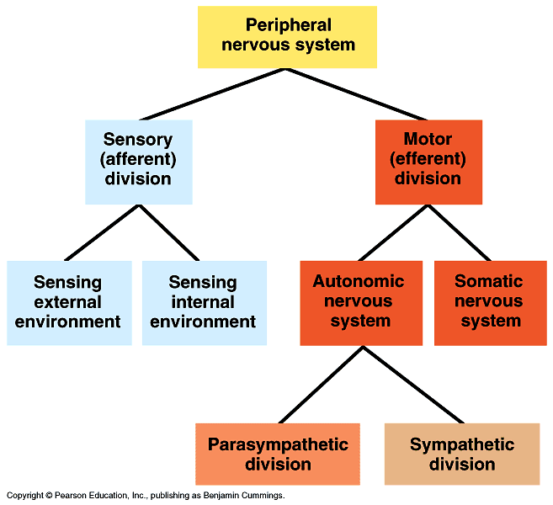
Functional hierarchy of the peripheral nervous system

Slide 37
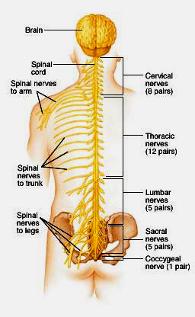
Spinal Cord
Somatic Nervous System
gets inputs from sensory receptors
and sends output to skeletal muscles

Slide 38
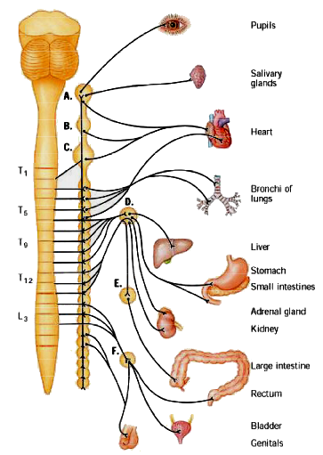
Sympathetic Nervous System
Nerves from spinal cord run to chain ganglia and then to glands and smooth muscle
mobilize energy
divert blood to muscle
prepare to fight/flee

Slide 39
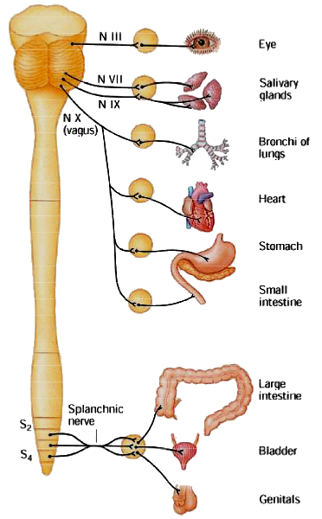
Parasympathetic
Nervous System
Nerves from brainstem and spinal cord run to glands and smooth muscle
Prepare for digestion, energy storage, divert blood flow to gut.
opposite effect of sympathetic NS

Slide 40
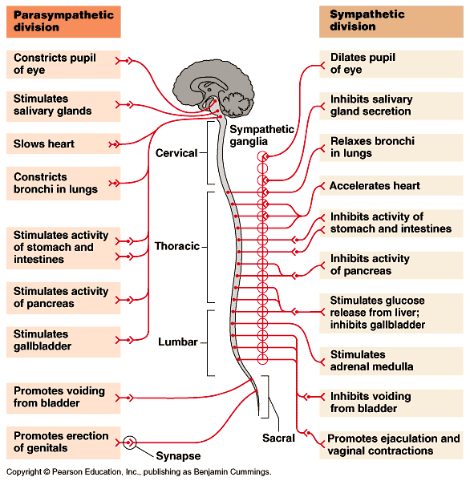

Slide 41
Peripheral Nervous System:
Neurons and nerve fibers outside the brain and spinal cord
motor neurons
cranial nerve
sensory ganglion
autonomic ganglion
sensory nerve
autonomic nerve
motor nerve
GI tract
enteric NS

Slide 42
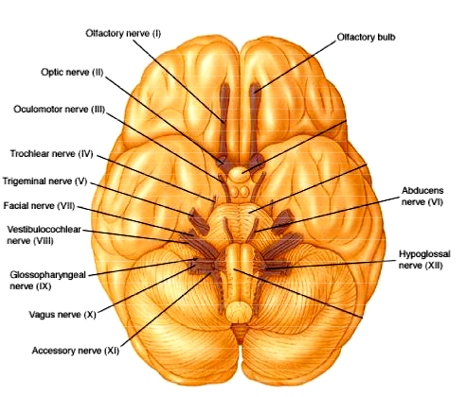
Cranial Nerves
Sensory and motor nerves that come straight to and from the brain
smell
vision & eyes
face
hearing &
balance
taste &
tongue

Slide 43
Central vs Peripheral Nervous System
chemically separated by Blood-Brain Barrier
cerebrum
cerebellum
brainstem
CNS
spinal cord
BBB
cranial nerve
sensory nerve
autonomic nerve
motor nerve
PNS
GI tract
enteric NS

Slide 44
Blood Brain Barrier BBB excludes large hydrophilic molecules like peptides, toxins, many drugs. Specific transporter enzymes on endothelial cells carry glucose, amino acids across BBB. Small molecules (e.g. O₂, CO₂) can pass and hydrophobic molecules like steroids can also pass through cell membranes.

Slide 45
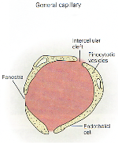
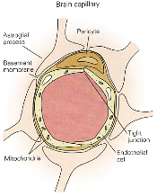
Blood Brain Barrier Tight junctions and pericytes seal off brain capillaries. Circumventricular organs are an exception.
Periphery
CVOs
Brain

Slide 46
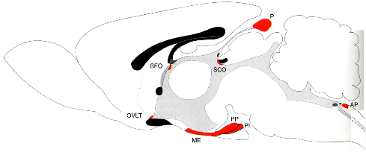
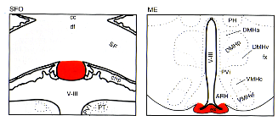
Circumventricular organs
Circumventricular Organs
cerebellum
olfactory bulb
brainstem
Subfornical organ
Median eminence

Slide 47
cerebellum
Dorsal
cerebrum
brainstem
spinal cord
motor neurons
cranial nerve
sensory ganglion
autonomic ganglion
Rostral
autonomic nerve
motor nerve
sensory nerve
Caudal
GI tract
enteric NS
Ventral

Slide 48
Views of the Nervous System
Anatomical
what is the location and connections of a brain structure; what are the effects of oblating that structure?
Evolutionary/ Developmental
what are evolutionary and developmental origins of a structure, and how does that explain current function and connections?
Functional Subsystems
what are functional and structural modules underlying a particular set of behavioral, autonomic, or cognitive functions? (e.g. somatic NS vs. autonomic NS).
Pharmacological
what drugs have access to and influence on a particular structure?

Slide 49
Pharmacological View of Nervous System in vivo
Several compartments: gut, blood, tissue, brain, CSF
csf
BBB
blood
autonomic ganglion
fat
autonomic nerve
kidney
liver
GI tract

Slide 50
Systemic Water-Soluble (Hydrophilic) Drug:
Acts on PNS, but excluded from CNS by BBB.
After oral, intravenous, or systemic injection,
easily passes into blood;
eliminated via liver,kidney, or gut.
csf
BBB
blood
autonomic ganglion
fat
autonomic nerve
x
kidney
liver
GI tract

Slide 51
Central Water-Soluble (Hydrophilic) Drug:
Acts on CNS, might act on PNS if enough leaks from CNS via CVOs.
Central injection straight into brain tissue or into ventricles gets the drug around the BBB.
csf
BBB
blood
autonomic ganglion
fat
autonomic nerve
kidney
liver
GI tract

Slide 52
Systemic Lipid-Soluble (Hydrophobic) Drug:
Acts on PNS and CNS.
Hydrophobic drug penetrates cell membranes (including skin and BBB).
Because lipophilic, may get build-up in fat.
csf
BBB
blood
autonomic ganglion
fat
autonomic nerve
kidney
liver
GI tract

Slide 53
Systemic Lipid-Soluble (Hydrophobic) Drug:
Acts on PNS and CNS.
Hydrophobic drug penetrates cell membranes (including skin and BBB).
Because lipophilic, may get build-up in fat.
csf
BBB
blood
autonomic ganglion
fat
autonomic nerve
kidney
liver
GI tract

Slide 54
Drug Properties
Large, hydrophilic molecules cannot cross the blood brain barrier. So for a peripheral chemical to affect the brain, the chemical must be able to do one of the following:
Indirectly affect the brain by acting on peripheral nerves outside the BBB that send a neural signal to the brain
cholecystokinin, a peptide that decreases feeding by sending a satiety signal via the vagus nerve to the brain.
Be carried across the BBB by a transporter on the walls of brain capillaries, or affect the brain capillaries directly
L-DOPA for Parkinson’s disease is transported as an amino acid;
ibuprofen acts on endothelial cells of BBB to affect prostaglandin release into brain.
Be able to pass directly through the cell membranes of the BBB.
steroids used to control brain inflammation;
benzodiazepines and barbituates.

Slide 55
Levels of analysis of a neuron
Where is the cell body of the neuron located?
Where is the dendritic field (inputs) of the neuron?
Where does the neuron send its axon (outputs)?
What functional system is the neuron part of?
What types of drugs can access the neuron?
What input does the neuron get, and what receptors are present postsynaptically?
What transmitters does the neuron release presynaptically?
What are the intracellular signaling and transcriptional networks that modulate long-term function of the neuron?

